Slide 1



Turing Halting Problem
Md. Jubayerul Hasan Mahin

Slide 2


Green University of Bangladesh
Department of Computer Science and Engineering
Semester: Fall 2024, BSc in CSE(DAY)
Section:223-D4
Turing Halting Problem
Submitted by, Md Jubayerul Hasan Mahin
(213902127)
Dept. of CSE Green University of Bangladesh
Submitted to, Md. Abu Rumman Refat
Lecturer
Dept. of CSE Green University of Bangladesh

Slide 3
Introduction
Definition: The Halting Problem, introduced by Alan Turing in 1936, asks whether a computer program will finish running or continue to execute forever.
Significance: A cornerstone question in computability and theoretical computer science.
Key Concept: Decidability – Can a problem always be resolved with an algorithm?

Slide 4
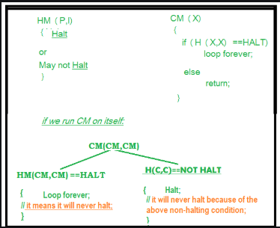
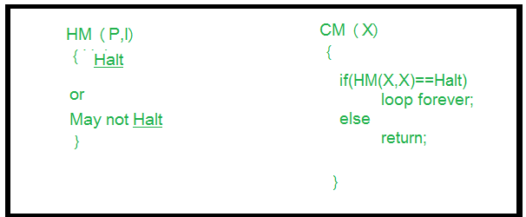
Halting Problem Illustration
Problem statement:
Can we design a machine that if given a program can find out if that program will always halt or not halt on a particular input?

Slide 5
Why is it Undecidable?
Turing's Proof:
Assumes the existence of a halting-deciding machine `H`. Demonstrates a contradiction when `H` analyzes a program that calls itself.
Conclusion: No algorithm can universally determine the halting problem for all programs.
Impact: Limits on what can be computed.

Slide 6
Implications & Conclusion
Implications:
The foundation of undecidability in computer science.
Influences complexity theory and computational limits.
Conclusion: The Halting Problem shows there are inherent limits to what computers can solve, guiding modern research in computability.

Slide 7
As Turing’s work shows, "Some questions are beyond the reach of computation."
Thank you!

